Slide 1
Mentor Development
University of Huddersfield Partners
September 2020
Jules Carroll

Slide 2
Our Mission basics of AFL
Our Initial Teacher Education programmes develop professional educators whose purpose is to transform the learning and life opportunities of the children, young people and adults with whom they work.
Through inclusive practice, reflection and commitment to continuous personal development, our trainees are empowered to become autonomous practitioners who enable all learners to realise their potential.

Slide 3
We aim to develop teachers who:
Holistic understanding of the role of a teacher
autonomous, confident professionals,
Use inclusive teaching techniques and philosophies
University of Huddersfield
Trainee Teacher
Are engaging practitioners
Use evidence based pedagogy
Are reflective and critical thinking
Strong subject and curriculum knowledge

Slide 4
Contacts
Sue Timmins Computing Tutor and School Direct Partnership Lead. s.timmins@hud.ac.uk
Julia Carroll Secondary Core Partnership Lead. j.p.c.carroll@hud.ac.uk
Ed Southall Course Leader. e.southall@hud.ac.uk
Placements team
sepdplacements@hud.ac.uk

Slide 5
2020/21 What’s new?
ITT Core Content Framework
Initial teacher education inspection framework
Summative reports -No grading

Slide 6
ITT Core Content Framework
Sets out the aims of a teacher-training programme.
Sets out the structure within which those aims should be implemented, including the knowledge, skills and behaviours to be gained at each stage.
It enables the evaluation of trainees’ knowledge and skills against those expectations.

Slide 7
Initial teacher education inspection framework
Two key judgements:
quality of education and training
leadership and management.

Slide 8
ITT Core Content Framework

Slide 9
Key Focus
Clear vision
Joined Up
Cohesion
Sequencing
Theoretically informed
Subject Knowledge
Communication
Role Models

Slide 10
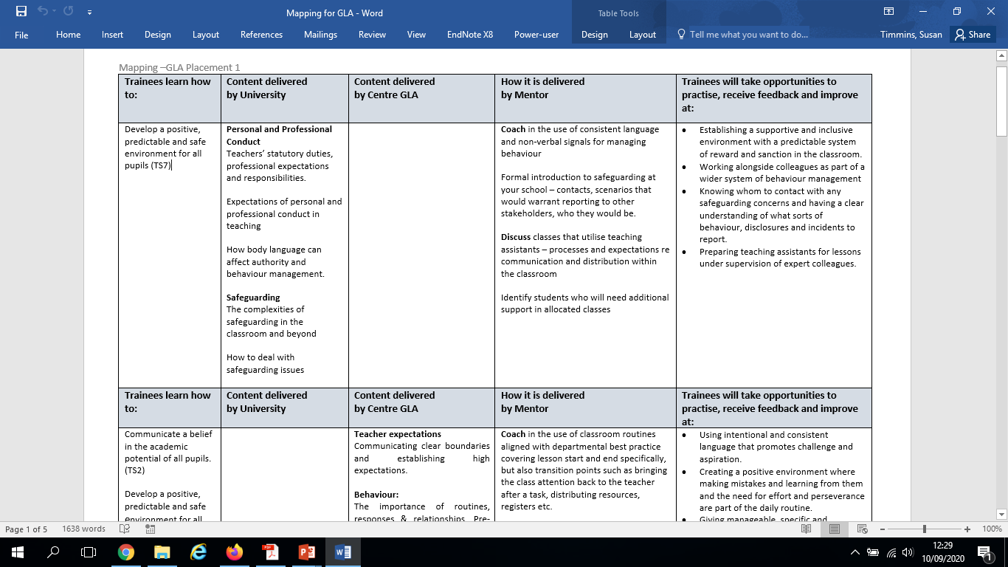
Mapping

Slide 11
Mentor /Trainee Relationship
Professional relationship which involves both guidance and assessment.
Trainees have to be prepared to receive constructive criticism and to be challenged to reflect upon their practice.
advice needs to be constructive, clear and explicit and the guidelines for this should be shared and agreed at the beginning of the relationship.

Slide 12
Mentor /Trainee Relationship
The mentor is a ‘role-model’ in their own classroom and the trainee will often seek to emulate them in every way.
The trainee is developing their own teaching identity.
As a mentor you are not seeking to develop a clone of yourself.

Slide 13
Lesson Observations
By host teacher, Mentor or Professional mentor.
There have been some changes to last years – please use the current one.

Slide 15
Giving Feedback
One or more observation per week
Focus on the positive as well as the areas for improvement, begin with ‘what went well’.
Remember the purpose of feedback, and ‘feed-forward’
Commenting on everything that happened in the lesson in a chronological, narrative form (i.e. a running commentary) isn’t especially helpful. Too much input for the trainee to process.
Link feedback to on-going targets and how these are being met. Select key themes that can then be developed into new targets.
Feedback is a type of assessment for learning.

Slide 16
Exploring the success of a lesson
How do you think it went?
What did you want them to learn?
Did they learn it?
How do you know?

Slide 18
Live coaching
Trainee Identify targets for progress
Positivity
Ask them to make notes to refer back to in ROP meetings.

Slide 19
Target Setting
It is vital to monitor targets during the weekly meeting when last week’s targets are reviewed before the next are set.
Targets need to be clear and specific – the aim is to be able to address them within the week.
Complete ROP’s at weekly meeting

Slide 21
Observation of Other Practitioners
Some targets are best addressed by having the opportunity to observe a range of colleagues in practice
Can be undertaken during the trainee’s Professional Development (PD) time.
Once a model of good practice has been identified by the mentor it is the trainee’s responsibility to follow up and arrange such opportunities.

Slide 22
Coaching opportunities for Placement 1
SHARE & EXPLAIN:
OBSERVE & DECONSTRUCT
DISCUSS & ANALYSE
OBSERVE & FEEDBACK
TEAM TEACHING
Notes:
SHARE & EXPLAIN:
This is an opportunity to explore the theory behind policy and practice. Example: Follow BM Policy – Mentor shares and explains both the practical systems but also the rationale behind them – routines/rewards/sanctions/seating plans/class systems e.g. numbers allowed in provision areas.
OBSERVE & DECONSTRUCT: While the mentor will undertake regular observations of their trainee’s lessons the trainees also need to be making structured observations both of their class mentor and identified colleagues. to identify effective practice and its impact on learning. Trainees in the early stages of training should be advised to focus on specific areas and not the whole lesson e.g. behaviour management or differentiation.
DISCUSS & ANALYSE: This approach could be a guided observation in which the mentor and the trainee observe and discuss another person teaching. This is an opportunity for ‘live coaching’ as the mentor narrates the effective delivery of a focused/targeted area e.g. strategies for ‘active learning’ that maximise participation.
OBSERVE & FEEDBACK This approach could be a focused observation on an aspect of the trainee’s teaching that they are trying to improve. The mentor could discuss with the trainee the evidence that could be used to evaluate their progress.
TEAM TEACHING: Sometimes the best way to understand a teaching strategy is not only to observe it, but to also to deliver it within a supportive structure. Team teaching one or a series of lessons allows for immediate feedback and implementing of skills – it also allows for ‘risk taking’ with the knowledge that the mentor will act as a ‘safety net’ should it be necessary. Again, negotiating the ground rules for immediate, but tactful, interjections within a trainee’s lessons allows for things to get back on track smoothly and immediately without the trainee feeling undermined or losing confidence.

Slide 23
The Key areas to develop Placement 1
Developing Teacher Presence
Ability to manage groups/class using clear and consistent language/following the school Behaviour Management Policy
Ability to plan individual lessons/a short sequence of lessons with an awareness of both prior knowledge and common misconceptions
Plan – evaluate – review cycle. To include a focus on questioning and formative assessment strategies
Ability to give clear exposition using clear and consistent language
Understanding of what ‘modelling’ is and ability to put into practice – focusing on the chunking of learning/minimising of complexity
Working productively alongside colleagues – deployment of TAs
Notes:
Developing Teacher Presence TS1 TS4 TS7 TS8
Ability to manage groups/class using clear and consistent language/following the school Behaviour Management Policy TS1 TS4 TS5 TS7
Ability to plan individual lessons/a short sequence of lessons with an awareness of both prior knowledge and common misconceptions TS3 TS4
Plan – evaluate – review cycle. To include a focus on questioning and formative assessment strategies TS2 TS4 TS5 TS6
Ability to give clear exposition using clear and consistent language TS1 TS2 TS3 TS4
Understanding of what ‘modelling’ is and ability to put into practice – focusing on the chunking of learning/minimising of complexity TS3 TS4
Working productively alongside colleagues – deployment of TAs TS5 TS8

Slide 24
Assessment –Summative Reports

Slide 25
Assessment process
Transparent
Open discussion
No surprises!

