Slide 1
Providing palliative care: research exploring the impact of nursing, multi-disciplinary teams, and the wider community on care quality
Catherine Walshe

Slide 2
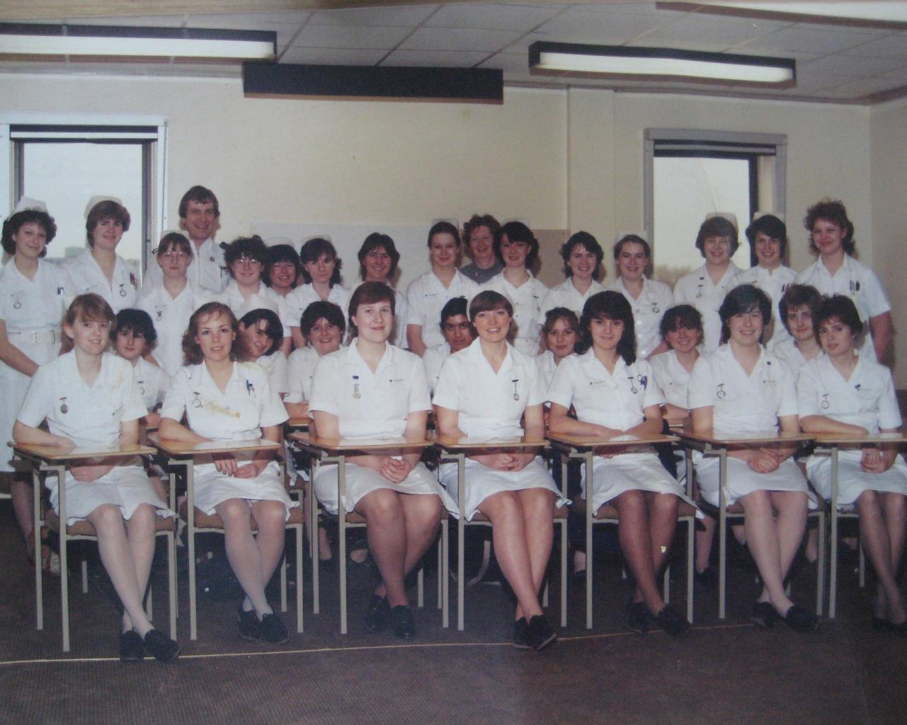
Notes:
I am a nurse. I am very proud of being a nurse, and my clinical background informs my current role as a researcher in palliative care. In this presentation rather than focus on one project, I’ve decided to briefly share findings from a few different projects which I hope illustrate some of the breadth of interests in research that I, a nurse, have.

Slide 3
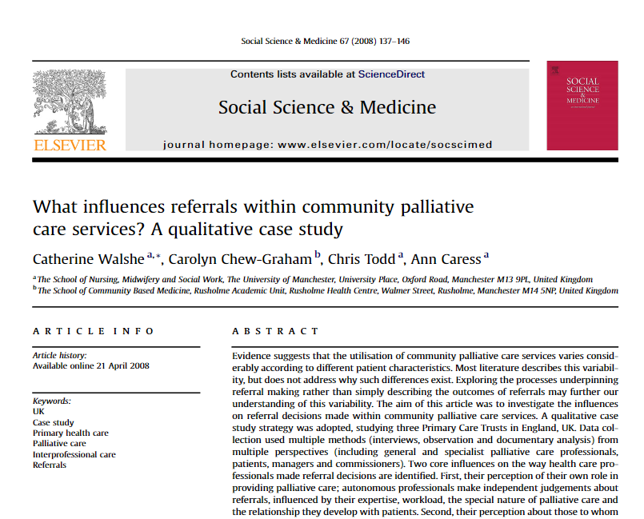
Notes:
I’m going to start by briefly mentioning the research that I did for my PhD. It wasn’t focused on nursing per se, but my as with all my research, it is informed by my nursing experiences. In this instance I was exploring what influenced referrals of patients with palliative care needs across and between community palliative care services. I used a multiple case study strategy, incorporating the perspectives of generalist and specialist palliative care providers, patients, managers and commissioners.

Slide 4
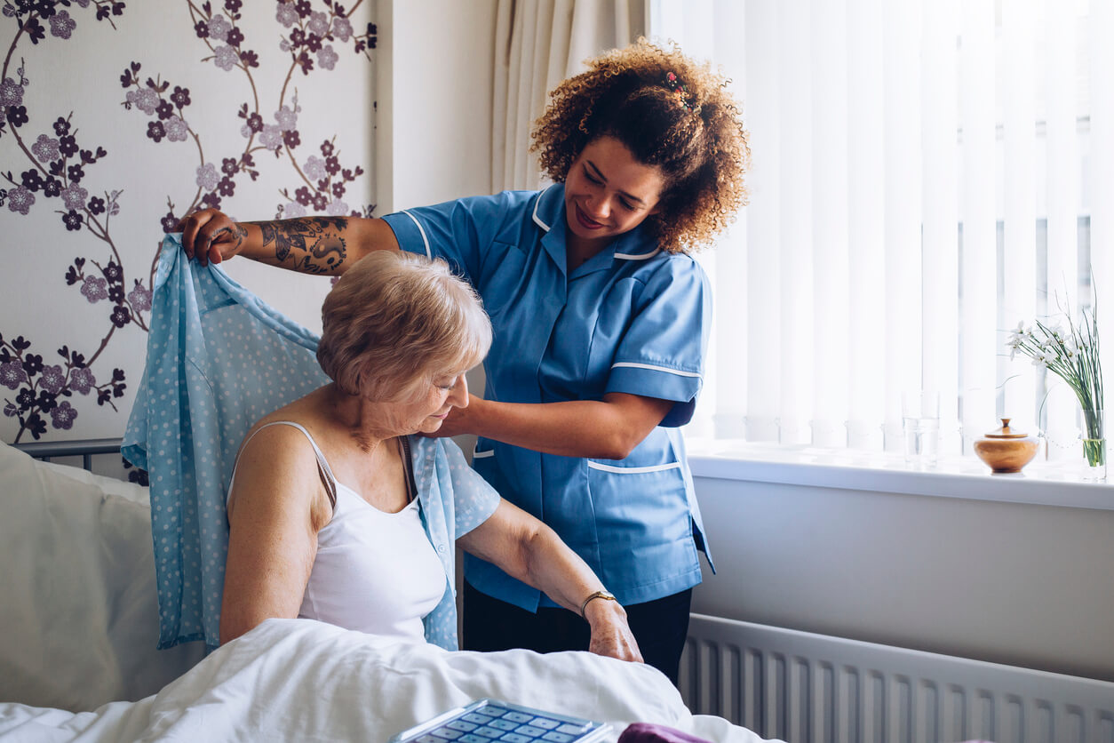
Perception of own role
Notes:
Two main issues affected referrals. First, their perception of their own role in providing palliative care; autonomous professionals make independent judgements about referrals, influenced by their expertise, workload, the special nature of palliative care and the relationship they develop with patients.

Slide 5
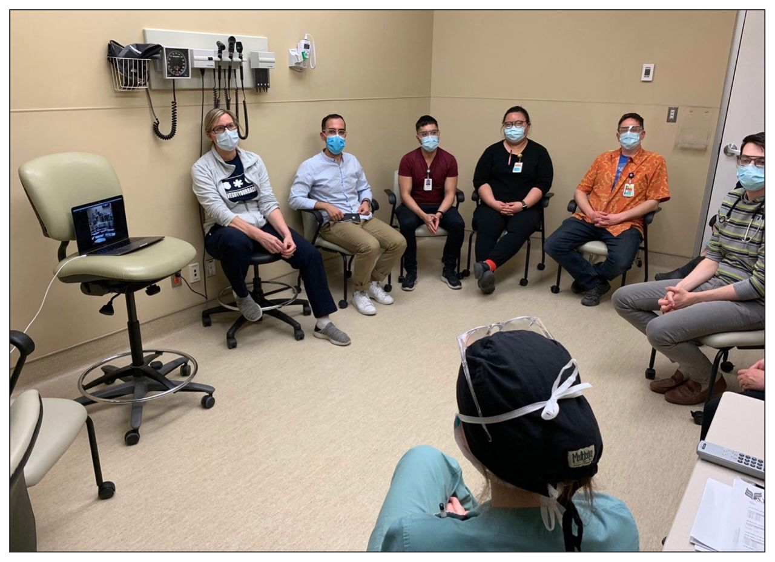
Perception of others to whom they refer
Notes:
Second, their perception about those to whom they may refer; professionals report needing to know about services to refer to, and then make a complex judgement about the professionals involved and what they could offer the referrer as well as the patient.

Slide 6
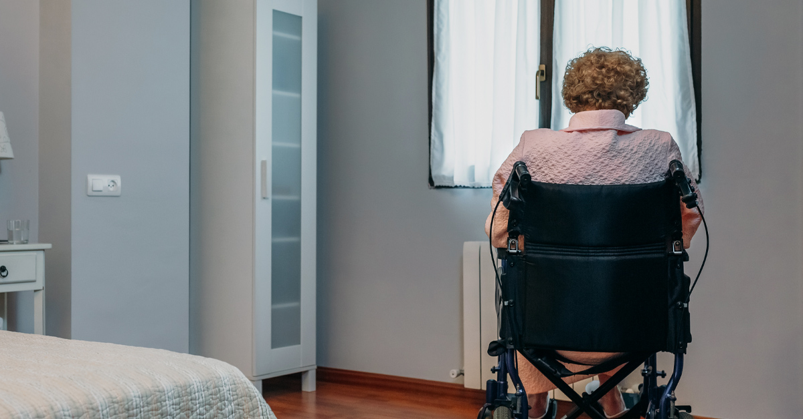
Complexity: not just patient need
Notes:
These findings indicate that many more factors than an assessment of patients' clinical need affect referrals within community palliative care services. It appears that personal, inter-personal and interprofessional factors have the potential to shape referral practices. Practitioners could be more explicit about influences on decision making, and policy makers take account of these complex influences on referrals rather than just mandating change.

Slide 7
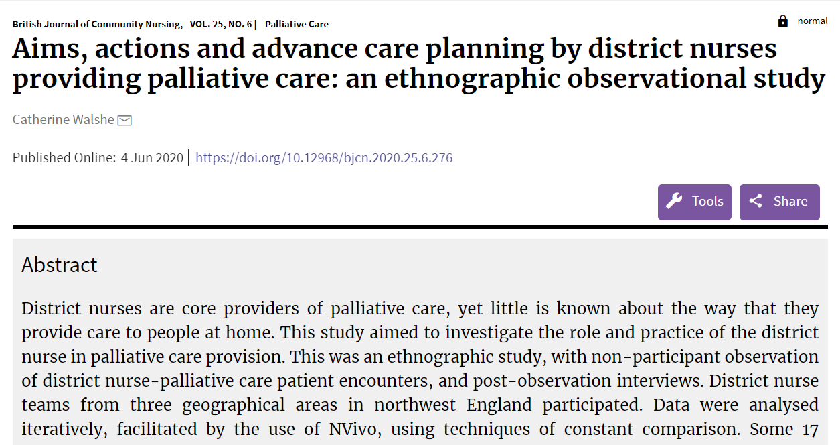
Notes:
Following on from this, I wanted to explore more about what nurses were actually doing when they provided care, the so called invisible care of district nurses. I observed nurse-patient encounters, and interviewed nurses and patients separately after the encounters.

Slide 8
Planning for the future
Notes:
In the interview data the nurses spoke a lot about how they developed relationships with patients to enable future care.

Slide 9
Caring in the moment
Notes:
Observations showed that much care actually focused on physical symptom management.. This is not to be negative about this, the care appeared effective and hugely appreciated by patients and family carers. But I think it illuminated some of the difference between what we do, and what we might hope that we do, and a need to appreciate a range of skills and their impact.

Slide 10
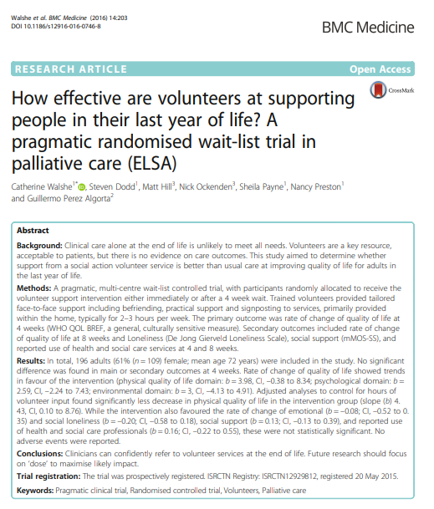
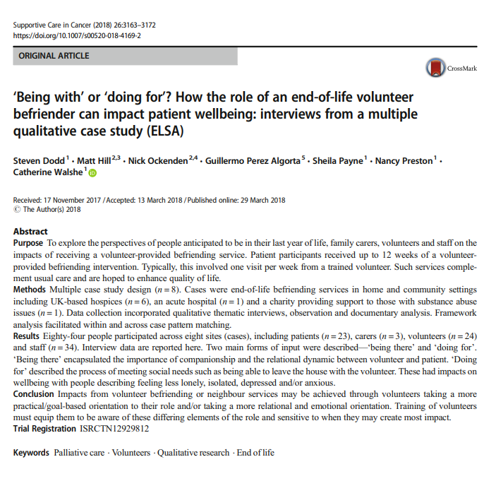
Notes:
Move on to focus on the wider ways that support and care are provided, focused on the role of volunteers in providing care as part of a wider team. This was in the context of a randomised controlled trial, with nested qualitative case study research.

Slide 11
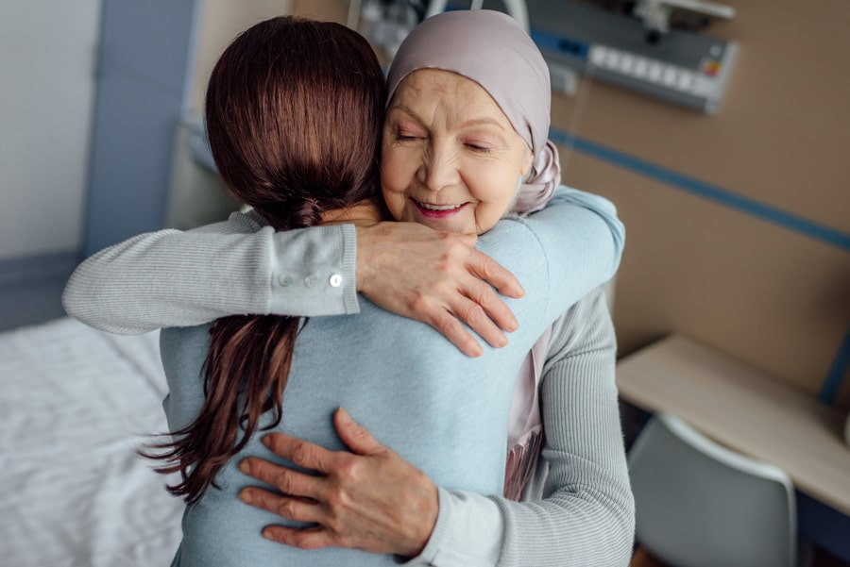
Reduction in rate of decline in quality of life

Slide 12
It comes from the heart
Notes:
This is a comment from one of the patients – that part of the impact of volunteers was because they ‘didn’t have to do it’ – it comes from the heart. These had impacts on wellbeing with people describing feeling less lonely, isolated, depressed and/or anxious.

Slide 13
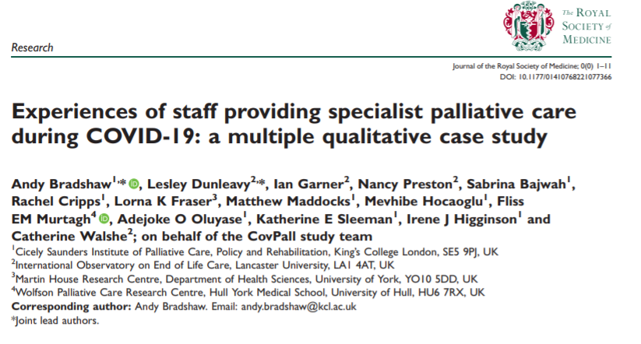

Slide 14
Moral distress
Infection control and values
Moral injuries
Managing moral distress
Moral comfort

Slide 15
…what stays with me the most are those conversations with loved ones and family members to say ‘I’m really sorry, we can’t enable a visit’ …. They have been some of the hardest conversations of my whole nursing career. … it just goes against the grain of everything we do
Notes:
A particular feature of the experiences described were procedures that had been in place around visiting policies that forced people to make decisions and operate in ways that were in opposition to the person centred values that they held. This included people having to inform families that visiting wasn’t allowed or that only limited visitors or visiting was permitted. Witnessing people dying without their families or loved ones present alongside having to deal with the conflicts that visiting restrictions caused was particularly distressing.

Slide 16
Some days I have really struggled … I have absolutely sobbed my heart out, thinking about what stuff I have gone through and seen and conversations that I have had to have
Notes:
These responses represented ‘moral injuries’, exemplifying the enduring psychological, emotional and physical harms of repeated exposure to moral distress.

Slide 17
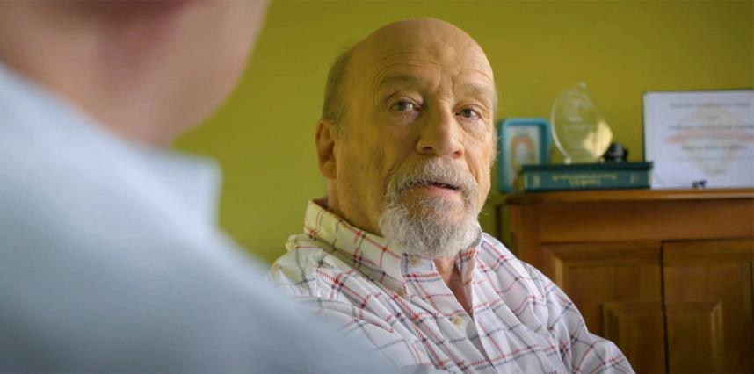
What we have learnt as a service is that we are a good team, that we can respond, that we’re respected and valuable members of our local health and social care system and that we can add value to that
This Photo by Unknown Author is licensed under CC BY
Notes:
Despite the impacts of moral distress, some participants spoke about how they experienced comfort in their situation as they felt they were making a valued contribution to the pandemic response

Slide 18
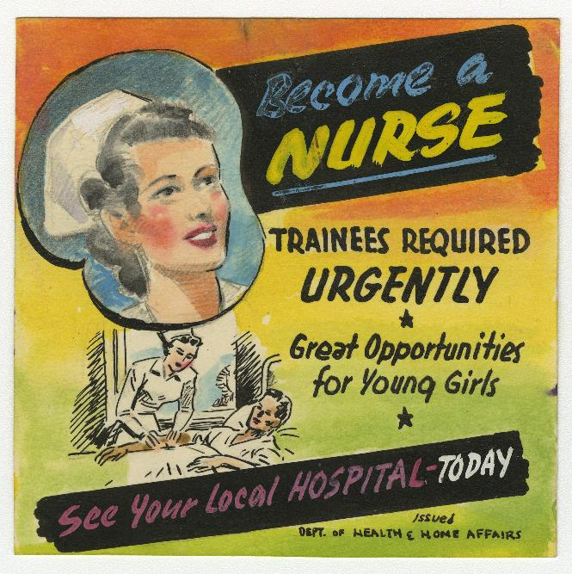

Slide 19
RESEARCHER
everyone
any care setting

